Slide 1


AN ORAL PRESENTATION ON STUDENT INDUSTRIAL WORK EXPERIENCE SCHEME (SIWES) UNDERTAKEN AT: GIS KONSULT (No 44, ADEYI AVENUE BODIJA,IBADAN, OYO STATE)
BY OFOBUTU ABIODUN EMMANUEL (RSG/17/2833)
THE DEPARTMENT OF REMOTE SENSING AND GEOSCIENCE INFORMATION SYSTEM
JANUARY 2023

Slide 2
OUTLINE
ABOUT PLACE OF ATTACHMENT: GIS KONSULT
HIGHLIGHT OF WORK DONE AND EXPERIENCE GAINED
CONCLUSION
CHALLENGES FACED
RECOMMENDATION
REFERENCE

Slide 3
INFORMATION ABOUT GIS KONSULT LIMITED
GIS KONSULT Ltd is a private GIS company owned and managed by Mr. David Afolayan, specialized in offering simple solutions to complex spatial problems by leveraging on Information Technology and Geographic Information Systems. The company is dedicated to helping provide insight, intelligence, and information that decision-makers can use to make smart decisions - be it governmental or non-governmental bodies.
GIS KONSULT Ltd was established on the 28th November,2007 with the registration number RC720071.

Slide 4
WHAT THEY DO
GIS KONSULT LTD provides a wide range of GIS solutions for end-users. Some of these solutions that the company produces include:
Mapping and Cartography
Training and Capacity Building
Project Development and Management
Spatial Data Acquisition and Analysis
GIS Infrastructure and Operations Hosting
Asset monitoring and security Management

Slide 5
PROJECTS UNDERTAKEN/ ENGAGED IN AND SKILLS ACQUIRED
Satellite imagery acquisition
Georeferencing of Image Maps for further analysis using different methods
Digitizing of features like roads, streams, etc using Arcgis and Arcgis online
Cartography.
Biodiversity Survey
Extraction of contours using Google earth pro
Flood Simulation mapping
Generating stream network and watershed
Spatial and surface analysis

Slide 6
GENERATING STREAM NETWORK AND WATERSHED OF ONDO STATE

Slide 7
AIMS
The aim of stream order and watershed mapping is to understand the hierarchical organization of streams and the drainage patterns within a given landscape. These provide valuable information for various applications in hydrology, ecology, and water resource management.

Slide 8
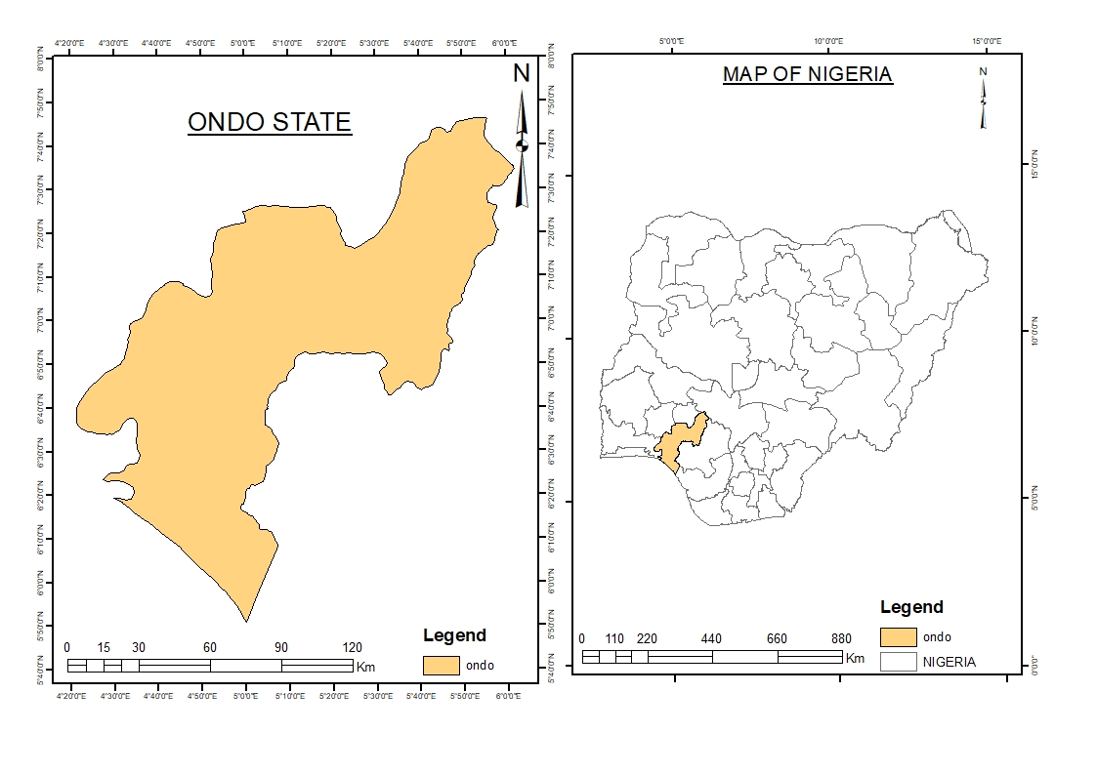
Ondo State is a state in southwestern Nigeria. It was created on 3rd of February 1976 from the former Western State.^{[4]} It borders Ekiti State to the north, Kogi State to the northeast, Edo State to the east, Delta State to the southeast, Ogun State to the southwest, Osun State to the northwest, and the Atlantic Ocean to the south.^{[5]} The state's capital is Akure,
STUDY AREA

Slide 9
Acquire Elevation Data
Fill
Flow Direction
Flow accumulation
Raster calculation
Watershed
Snap to pour point
Stream to feature
Stream Order

Slide 10
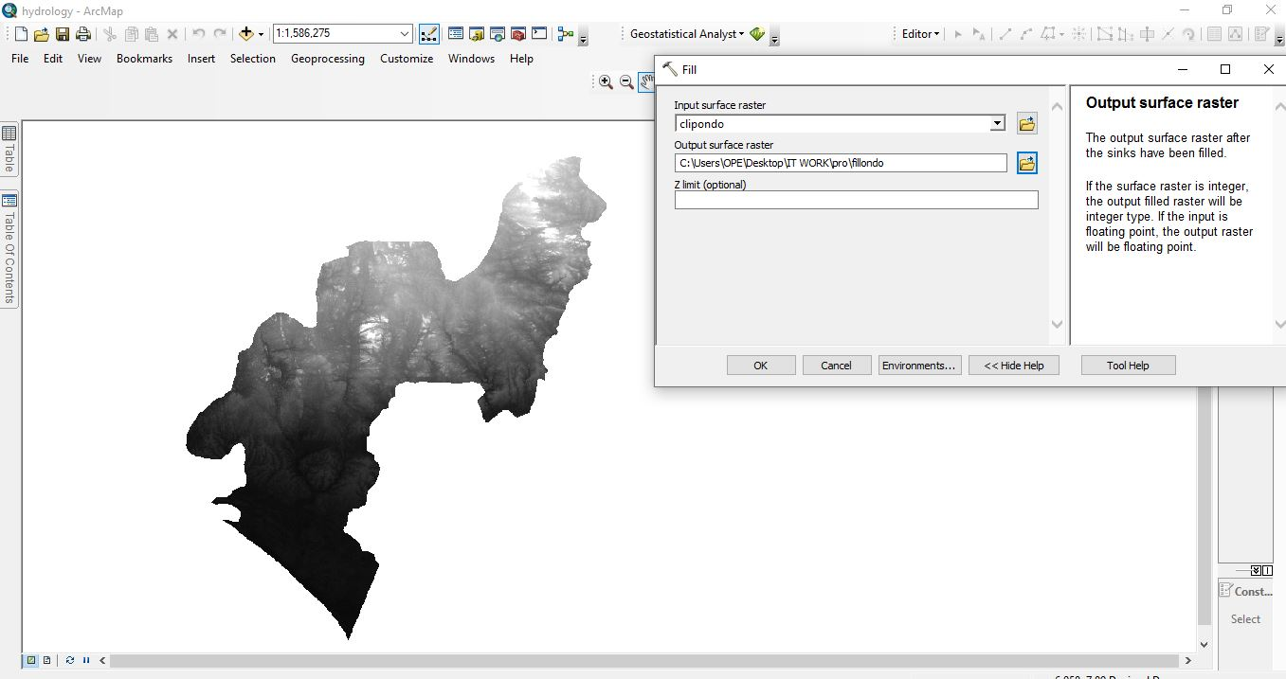
1.Filling the DEM: Fill sink in a surface raster to remove small imperfections from the data

Slide 11
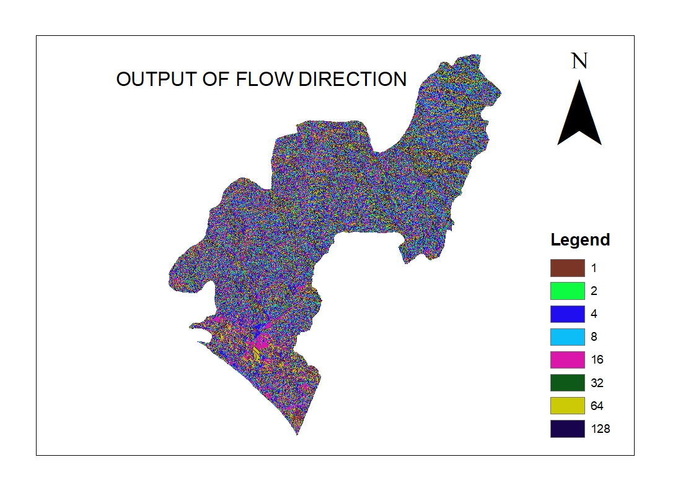
Flow direction of Ondo State
2.Generating flow direction from the filled DEM
The flow direction refers to the direction of water flow in a raster dataset representing a terrain or elevation model.
The Flow Direction tool will calculate the flow direction for each cell in the input raster dataset, assigning a value to each cell indicating the direction of flow.

Slide 12
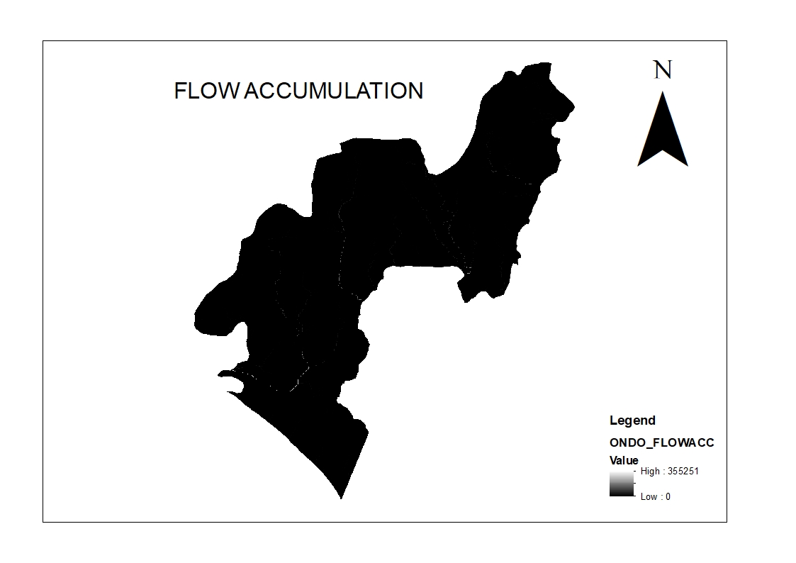
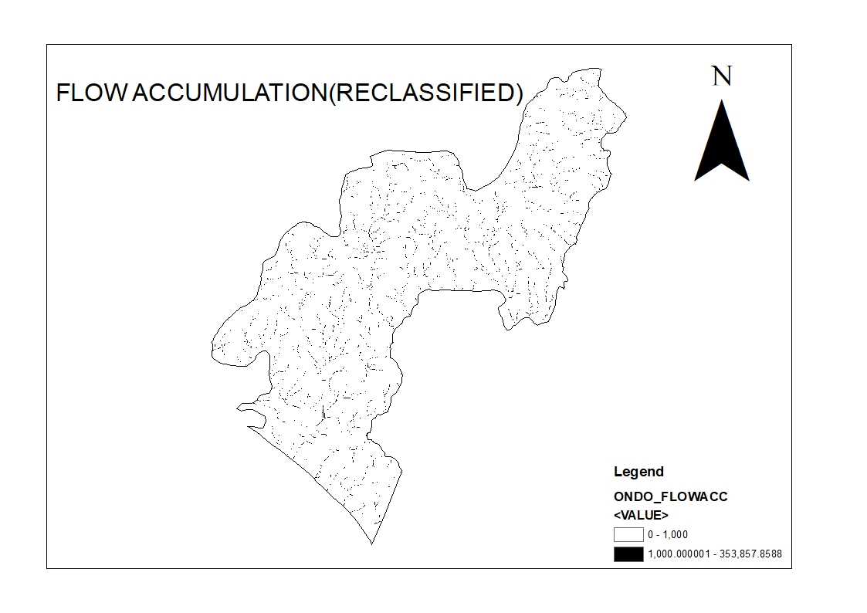
3.GENERATING FLOW ACCUMULATION
Flow accumulation is a process that calculates the accumulated flow of water through each cell in a raster dataset, based on the flow direction information. It helps identify the areas with higher water flow and can be useful for analyzing drainage patterns, flood risk assessments.
Reclassifying flow accumulation into two using raster calculator

Slide 13
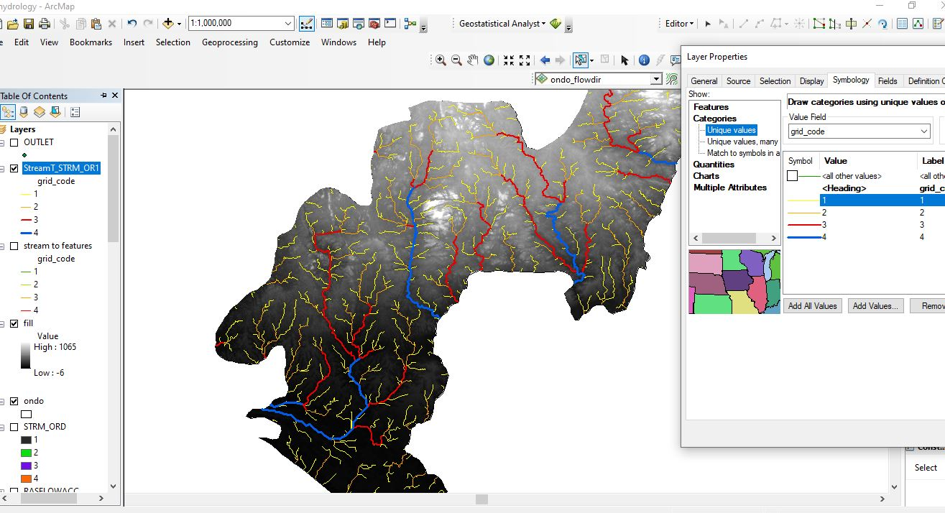
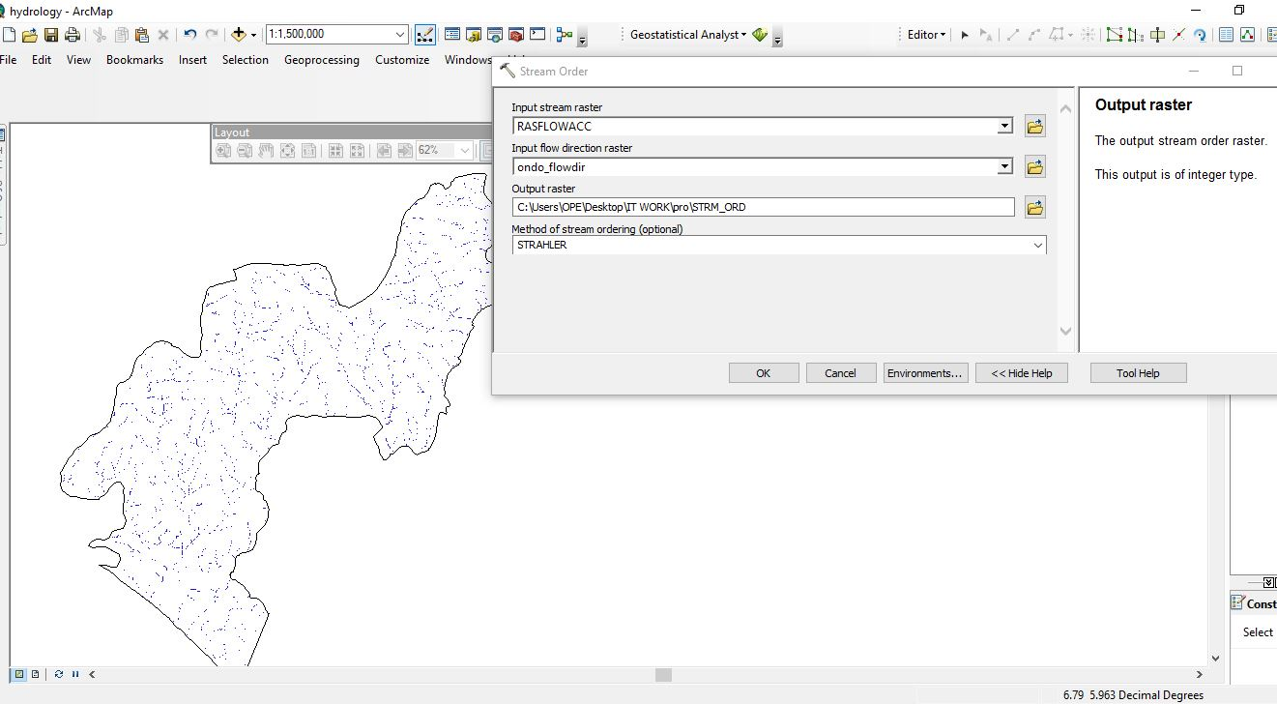
4 Using the "Stream Order" tool to assign stream orders to the stream network raster. This tool uses the Strahler method to classify the stream segments into hierarchical orders. The stream is classified into four orders
5. Stream to feature tool to convert stream order raster to feature(vector)

Slide 14
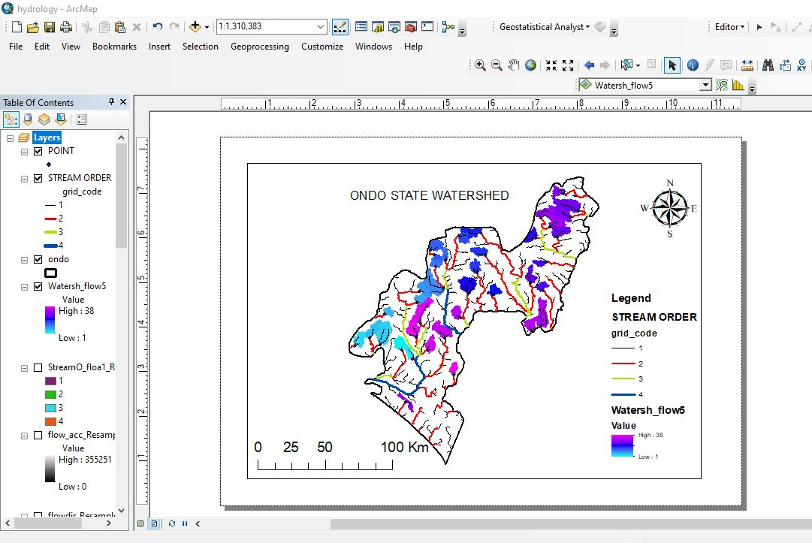
Identifying the pour point using the stream order information derived from the stream network, then using this pour point information for delineating watersheds

Slide 15
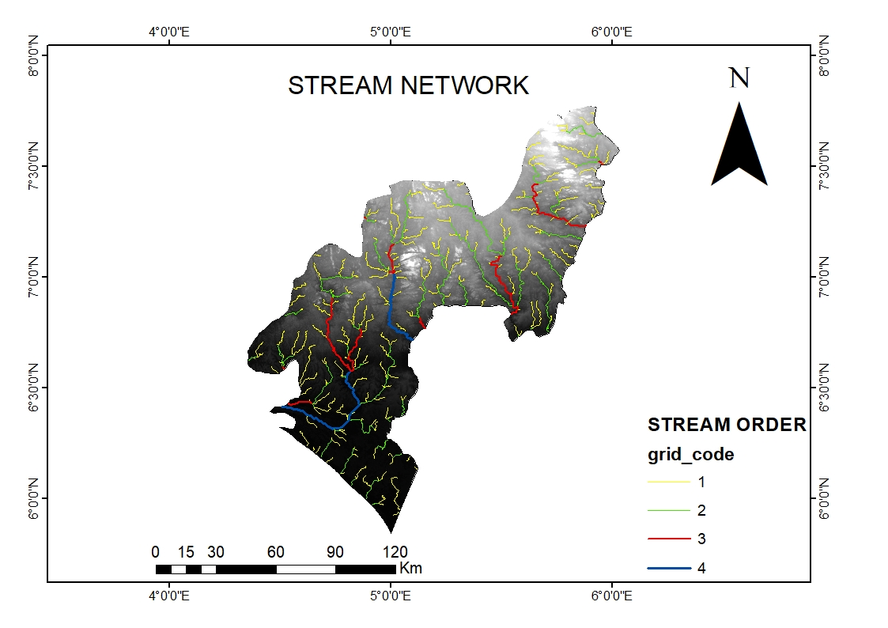
Ondo State stream Network
In summary, stream networks are critical components of hydrological analysis and water resource management. They provide insights into the organization, connectivity, and drainage patterns of streams, allowing for a better understanding of the hydrological processes within a watershed. Stream networks are valuable tools for assessing water availability, managing water resources, modeling floods, and evaluating the environmental impacts of human activities.

Slide 16
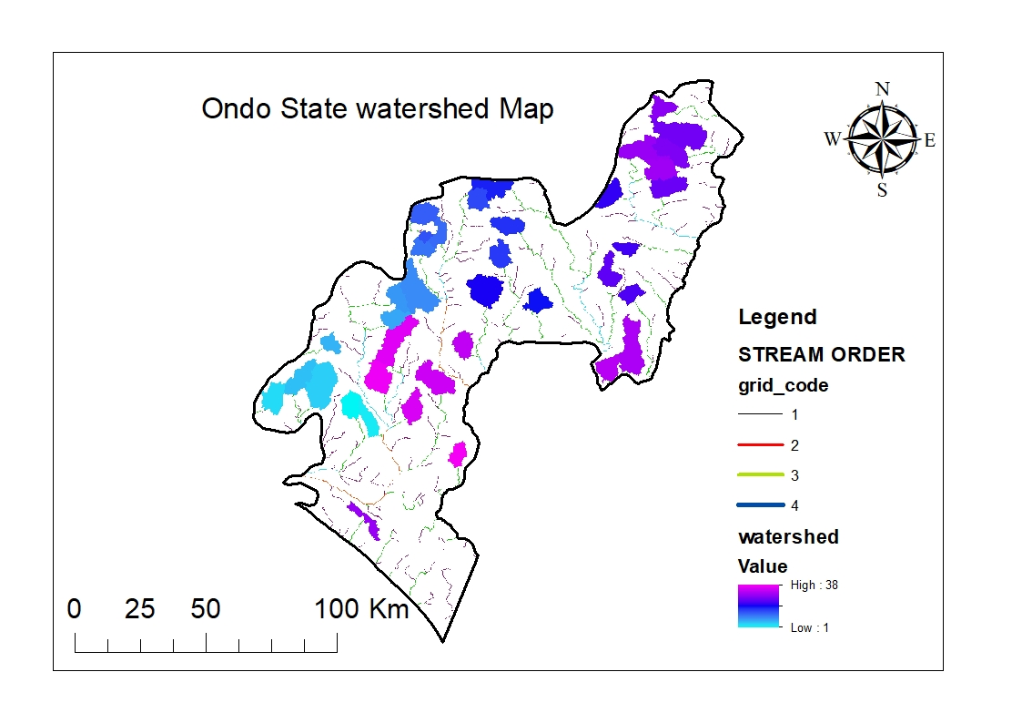
In summary, Watershed delineation allows for a better understanding of water movement, enables informed decision-making, and supports effective management of water resources and environmental protection efforts.
the health and proper management of watersheds are essential for sustaining ecosystems, ensuring clean water supplies, reducing the risk of floods, supporting biodiversity, and providing recreational and aesthetic values. Recognizing the importance of watersheds and implementing effective watershed management strategies is crucial for long-term environmental sustainability and human well-being.

Slide 17
CONCLUSION
Having completed the Student Industrial Work Experience Scheme (SIWES), I have gained valuable first-hand Industrial based practical experience of what the Remote Sensing and GIS industry entails.
The industrial training programme has bridged the gap between the theoretical and practical knowledge I already had with the skills required in the work environment.
The SIWES programme has also served as a life experience as I was able to gain some relevant skills that I know will be useful to me not only in the working environment.

Slide 18
CHALLENGES FACED
As is with anything worth doing at all, I faced quite a few challenges before and over the course of the Student Industrial Work Experience Scheme (SIWES). Some of which includes:
Difficulty in finding placement
Cash scarcity during the period of election
High cost of transportation from residential area to GIS consult.

Slide 19
RECOMMENDATION
Here are some recommendations that I believe can be useful in improving the Student Industrial Work Experience programme.
The department should capitalize on the places that previous sets have done their SIWES programme and establish a working relationship with them. This way, it will be far easier for students to easily secure Industrial Attachments when needed.
SIWES is a great initiative and it should be properly monitored by the institution to ensure that students are properly learning what they need to know about their industry.
IT is stressful, time consuming, and most importantly money consuming. ITF should therefore assist student by providing student with stipends that can support them during the internship.
GIS is quite diverse and touches different areas, so I am indulging all students to explore the application of GIS in different field of study to find what they find best for themselves.

Slide 20

THANK YOU FOR LISTENING

